Slide 1
Progress Report 8 - Demo Day
Sprint 8 - (4/2 - 4/16)
Brian Goughnour, Josh Brown, Steve Stamey, Guylain Kibunzi, Chauncey Davidson

Slide 2
Map
Goals
The user can navigate and traverse the map freely
The user can enter in an address and jump to that location
The user can select an address and add it to their list of addresses and locations (into the database)
The user can view their marked locations
Technologies
HTML/CSS
Javascript
Leaflet Methods/Imports

Slide 3
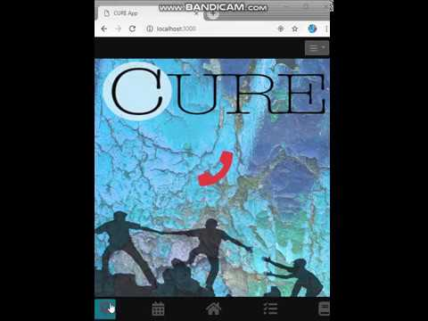

Slide 4
Goal Tracker
Goals
The user can create a new goal.
The newly created goal will be put into a list and go to the top.
The user can update the list as goals are completed.
A created goal can be removed from the list.
The submodule can accept new goals from other subsystems
Technologies
HTML
Javascript
CSS
Meteor
Mongo DB
Cordova for iOS translation

Slide 5
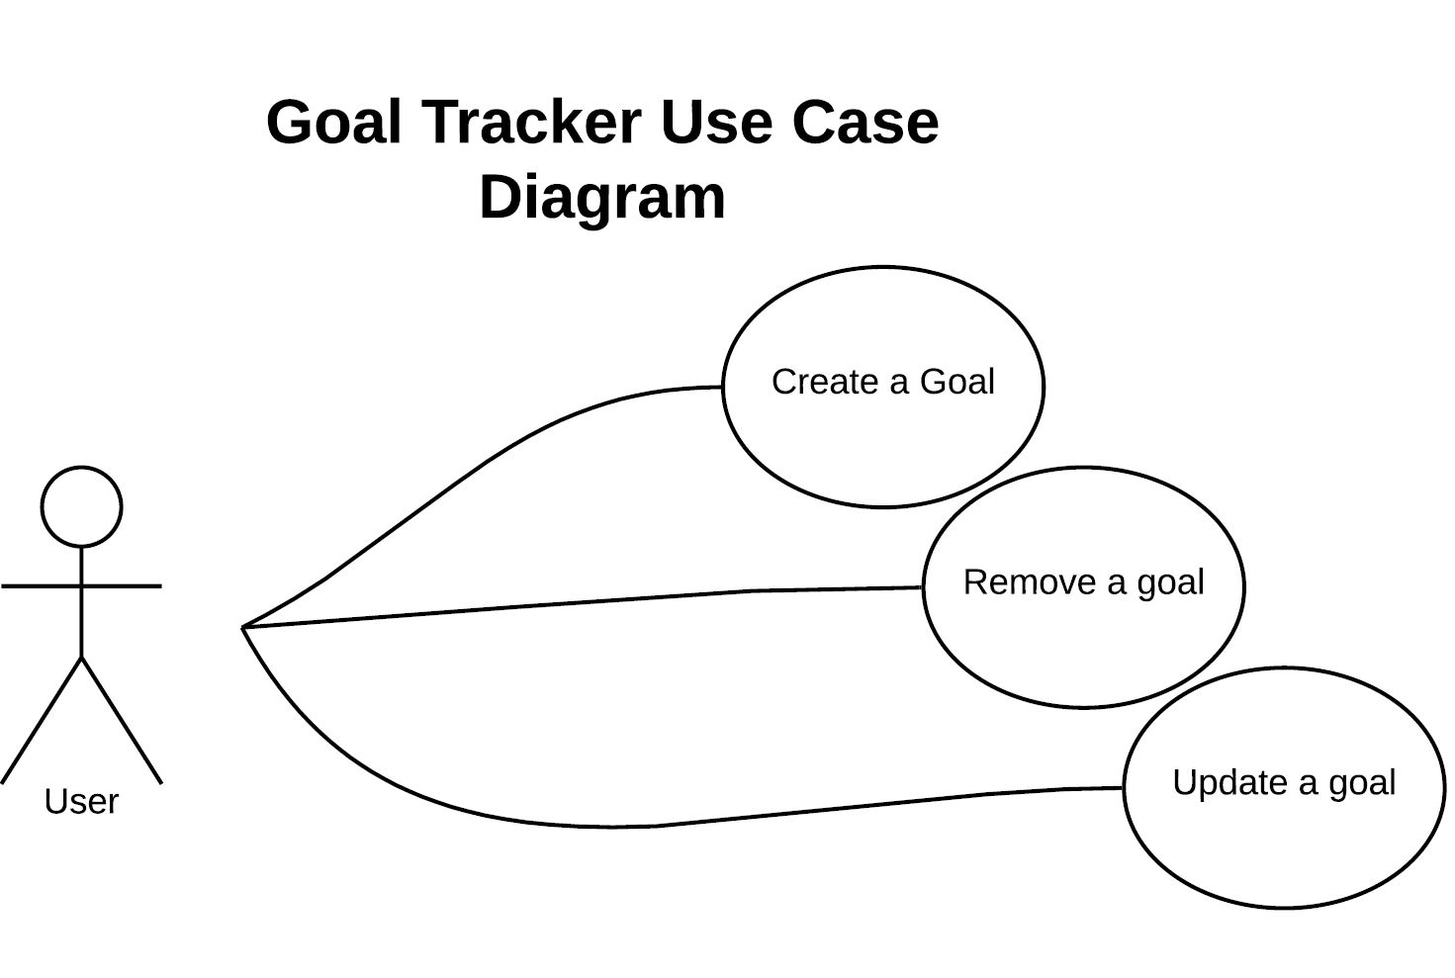
Goal Tracker Use Case Diagram

Slide 6
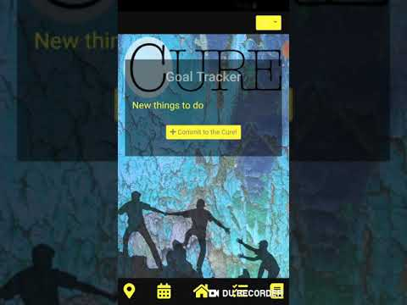

Slide 7
Education
http://localhost:3000/
http://localhost:3000/
Goals
Provide tools and resources to assist and support users.
Provide information about online course, course calendar, and certificates.
Educate community members about health career choices and recruit future professionals.
Provide user with information about clinical training experience.
Technologies
HTML
Javascript
CSS
Cordova
Meteor

Slide 8
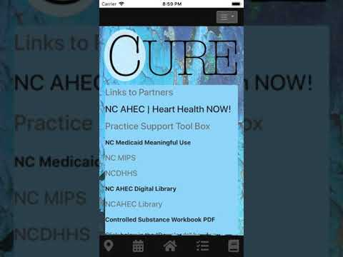

Slide 9
Hot Dial
Goals
Quick phone calls to emergency services
Add/Remove personal emergency contacts
Frameworks/Libraries:
Cordova phone calling via Android and iOS backend calls
Javascript backend
HTML frontend with Bootstrap/CSS for styling

Slide 10
Calendar
Goals
Provide easy interface for Calendar Events
Allow other subsystems (current and future) a method for updating native calendar when needed
Frameworks/Libraries:
Cordova for communication to native calendar
Javascript backend
HTML frontend with Bootstrap/CSS for styling

Slide 11
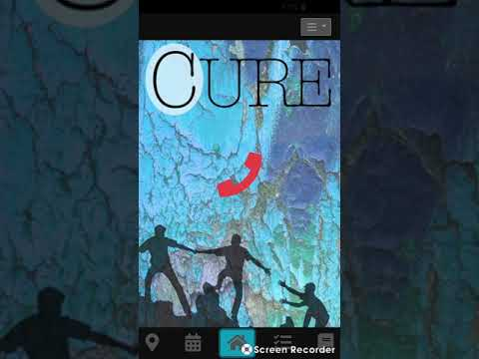

Slide 12
Settings
Goals
To allow users to customize app
Allow users to change the functionality and behavior of the application
Give users an option to create a profile; strengthens the bond within our community
Technologies
Languages
Javascript
HTML / CSS
Frameworks
Meteor - open source platform for mobile
Cordova - container for running apps on mobile
Libraries/ packages
NPM - touted as the world’s largest software registry
MongoDB - cross-platform database

Slide 13
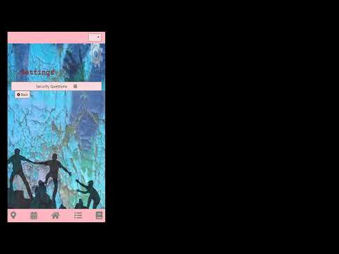

Slide 14
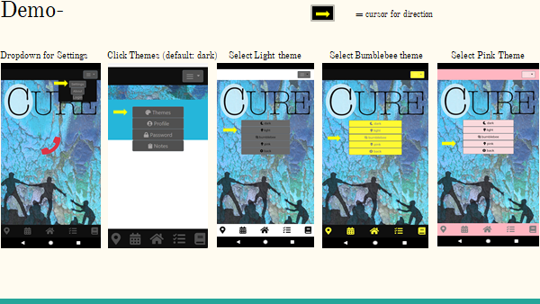

Slide 15
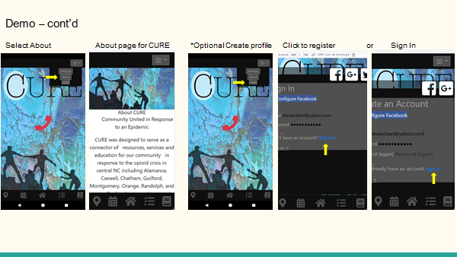

Slide 16
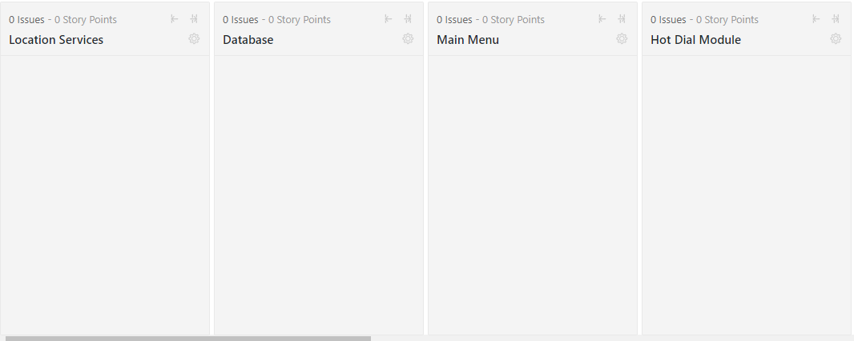
ZENHUB

Slide 17
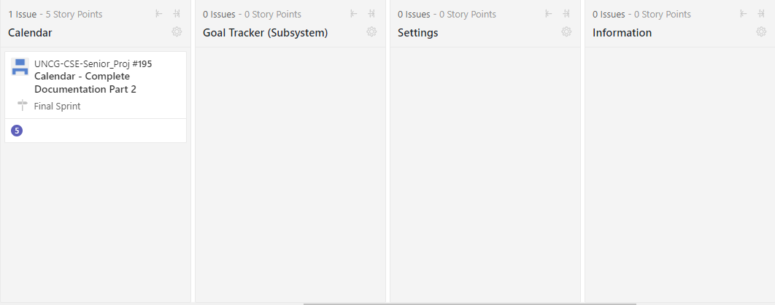
ZENHUB

